Slide 1
Comparison of MapReduce and Apache Spark
K.E.A.B.I. Edirisinghe - 239315X

Slide 2
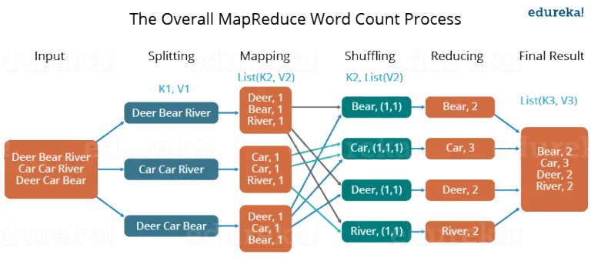
What is MapReduce?
Programming framework that allows to perform parallel and distributed processing on large data set in a distributed environment.
Notes:
Divide and Conquer algorithm
Moving processing to the data

Slide 3
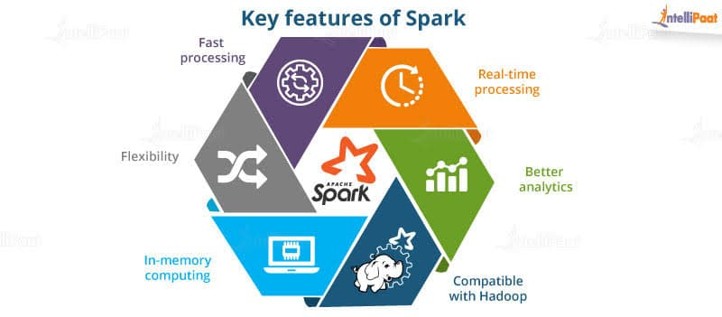
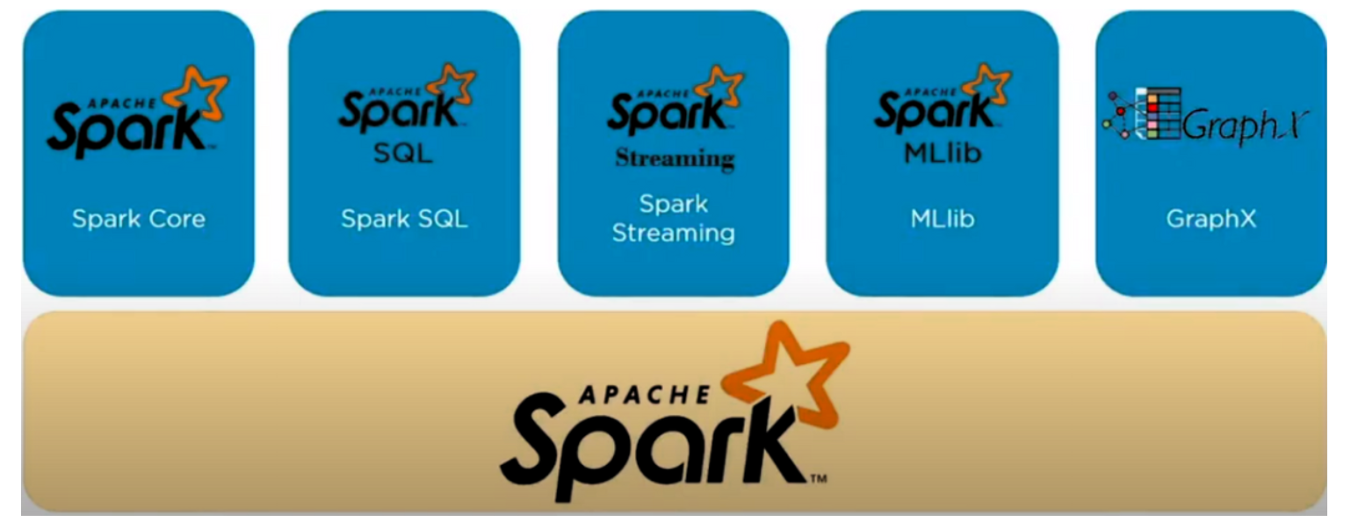
What is Apache Spark?
Apache Spark is an open-source, distributed processing system used for big data workloads. It utilizes in-memory caching, and optimized query execution for fast analytic queries against data of any size.

Slide 4
Demo

Slide 5
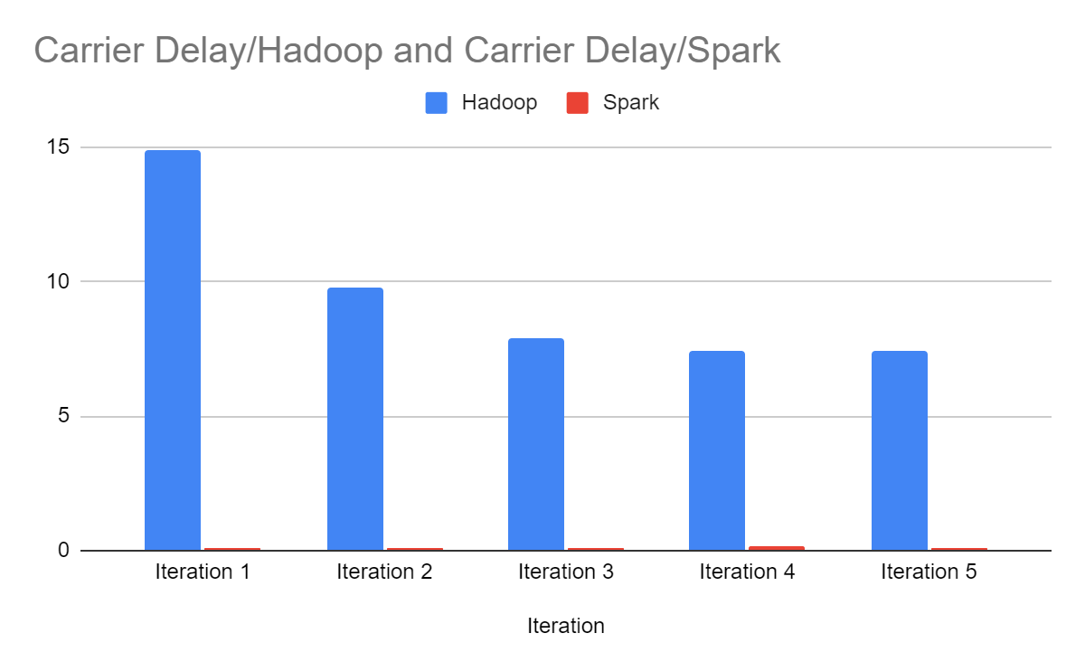
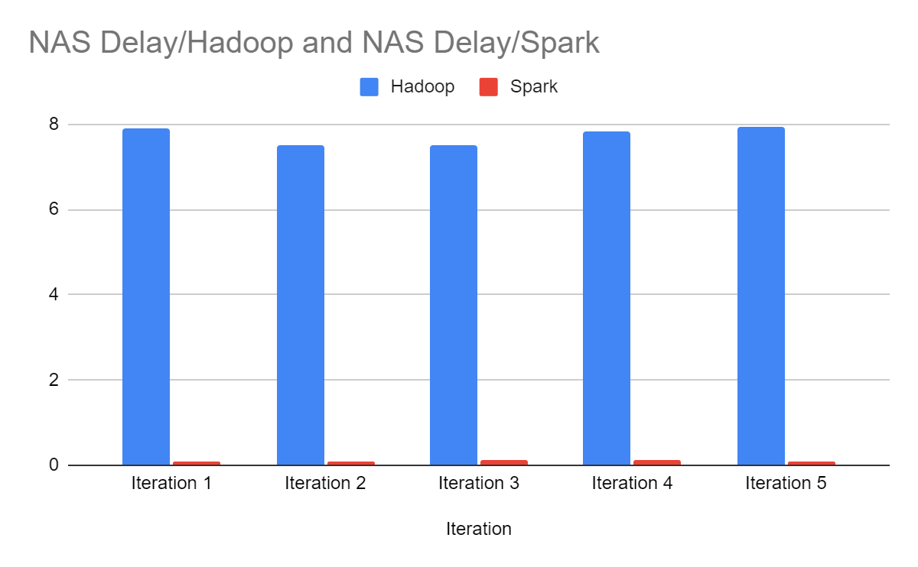
Results

Slide 6
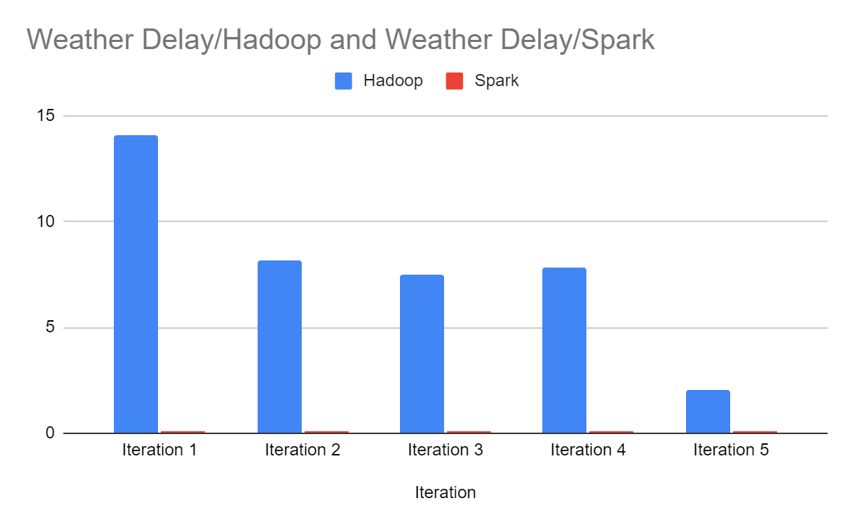
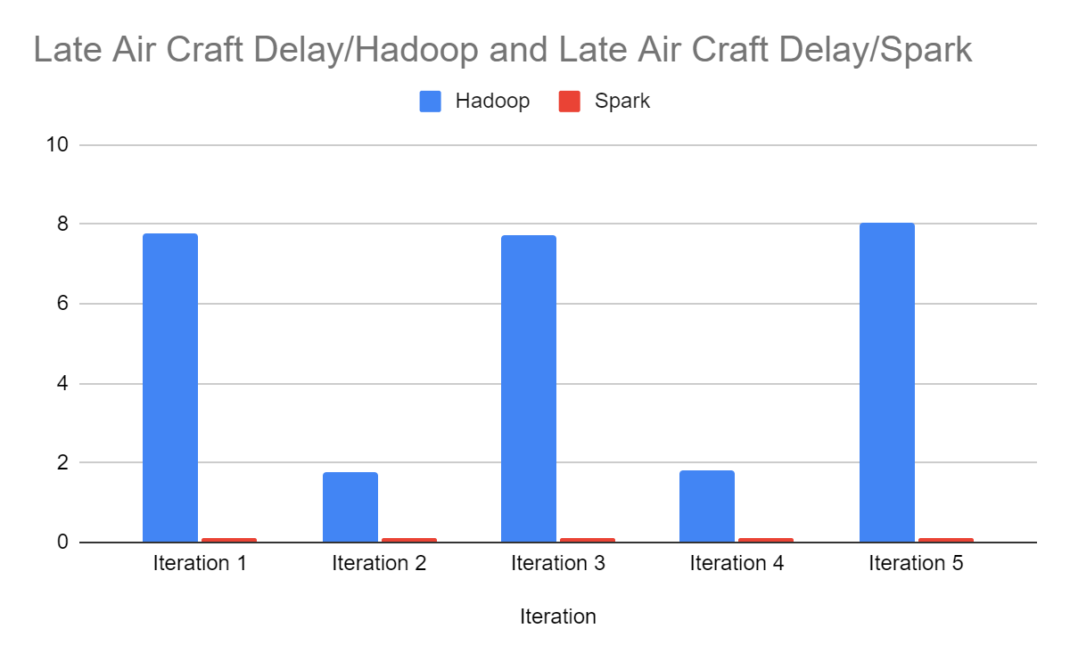

Slide 7
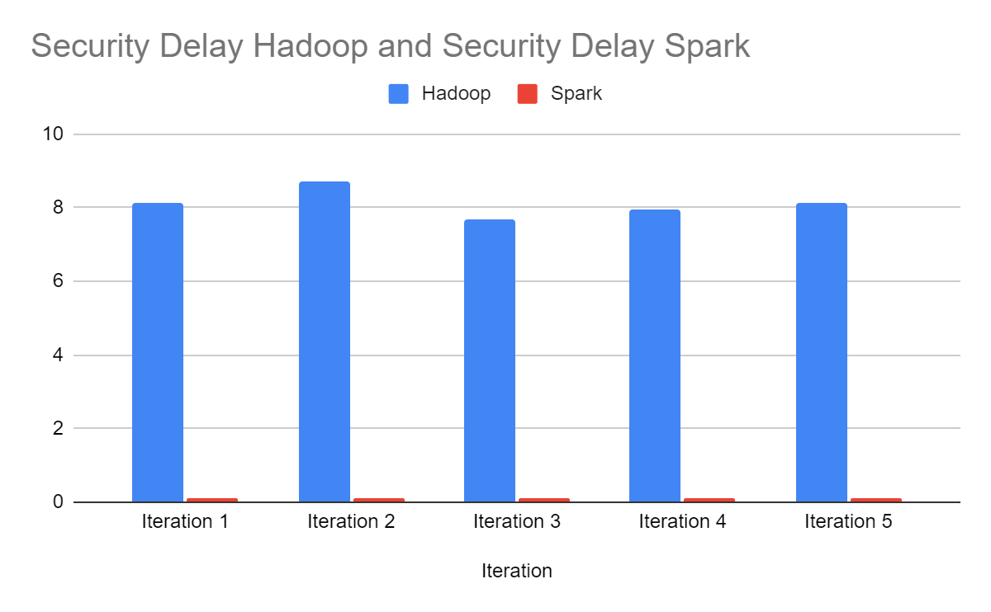
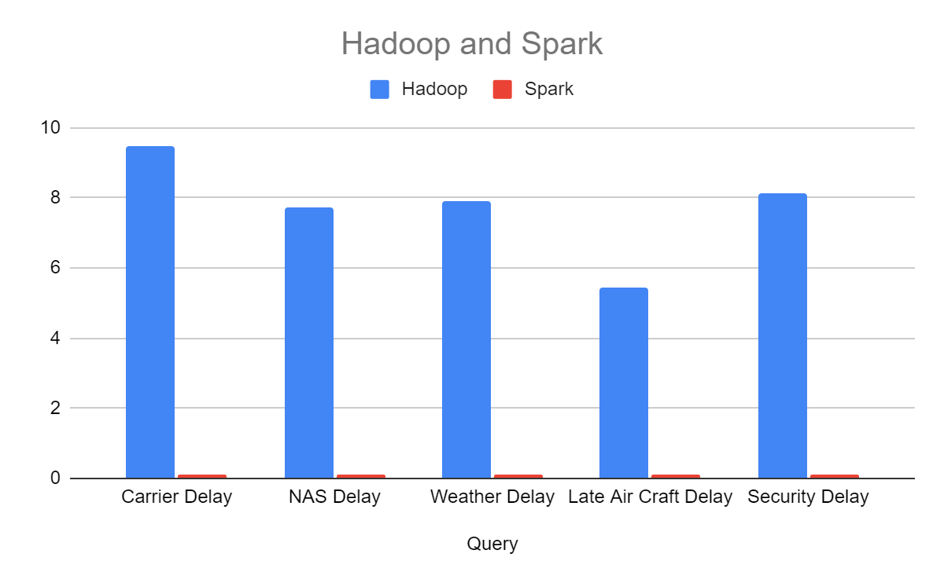

Slide 8
Hadoop MapReduce vs Apache Spark
 | Hadoop MapReduce | Apache Spark
Performance | Generally slow as it performs operations on the disk. Cannot deliver near real-time analytics from the data. | Runs x100 faster in-memory and x10 faster on disk. If spark runs on YARN with other resource demanding services, can be degradations
Ease of Use | Complex to use has there is no interactive mode and need to handle low level APIs to process the data. | Supports user-friendly APIs for different languages and has interactive mode and provide feedback for queries and actions

